Slide 1
منظومة ادارة البصمة والمعالم الحيوية Fingerprint & Biometrics Management
مقدمة وعرض مختصر
Biometric Identity Determination & Verification
أغسطس 2015

Slide 2
الأجندة
الجوانب الرئيسية للمعالم الحيوية Roman
Main Biometric methods:
Authentication: Process of Identification vs. Verification
What are the Biometric features: Fingerprints, Facial, IRIS & Voice
Comparison on: A) accuracy, B) speed of retrieval & C) drawbacks of each method
التطبيقات الرئيسية؟ Roman
Key Applications:
Sensitive & High security Government buildings
Border points
Refineries
Large-scale enrolment.
ادارة الهوية مقابل ادارة الصلاحية؟
Identity management vs. access management (Roman & Salman)
الأجهزة المستعملة – devices used : Salman
رحلة شركة الخدمات العامة مع منظومة ادارة البصمة : Salman
عرض للجوانب الرئيسية لمنظومة ادارة البصمة: Roman – overview the last 5 slides

Slide 3
Verification vs Identification
Verification refers to the information you need to obtain to confirm that your clients are who they say they are. It is based upon validating a biometric sample presented against a previously collected biometric sample for the individual.
1:1 matching;
requires an ID plus a biometric template for the matching;
Fast processing, involves only one matching;
Scenario:
A person is asked to provide an ID;
A fingerprint captured by a fingerprint reader;
An application then searches a database for a record registered with the given ID;
The application retrieves the content of the template fields previously saved in a record;
The application uses the Fingerprint Verification SDK to compare the captured template with the retrieved from the record;
The user is authenticated only if the matching returns true;

Slide 4
Identification system seeks to identify an unknown person, it is based upon comparison of biometric sample presented against a database of previously collected samples.
1:N matching;
Does not require an ID, only a biometric template for the matching;
Processing time dependent on N (the number) of templates;
Scenario:
A fingerprint captured by a fingerprint reader;
An application starts to iterate through all user records in a database;
The application retrieves the content of the template for each user in the database;
The application uses the Fingerprint Identification SDK to compare the captured template with the retrieved from the record;
The user is authenticated only if the matching returns true otherwise it keeps on doing the loop;

Slide 5

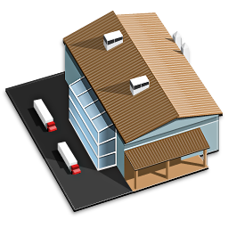



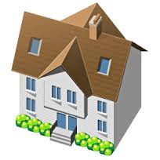



Slide 6

Neurotechnology provides algorithms and software development products for biometric fingerprint, face, iris, voice and palm print recognition, computer-based vision and object recognition to security companies, system integrators and hardware manufacturers. More than 2,500 system integrators and sensor providers in more than 100 countries license and integrate company's technology into their own products. With millions of customer installations worldwide, Neurotechnology's products are used for both civil and forensic applications, including border crossings, criminal investigations, systems for voter registration, verification and duplication checking, passport issuance and other national-scale projects. Drawing from years of academic research in the fields of neuroinformatics, image processing and pattern recognition, Neurotechnology was founded in 1990 in Vilnius, Lithuania under the name Neurotechnologija and released its first fingerprint identification system in 1991. Since that time the company has released more than 80 products and version upgrades for identification and verification of objects and personal identity.
International awards
In 2015 Neurotechnology's fingerprint identification algorithms have been judged by the National Institute of Standards and Technology (NIST) as one of the fastest and most accurate among the participants.
In 2009, 2012 and 2013 Neurotechnology's iris recognition algorithm has been judged by the National Institute of Standards and Technology (NIST) as one of the fastest and most accurate among the participants.
In the Fingerprint Verification Competition (FVC2006), Neurotechnology achieved the highest ranking when using the most realistic benchmark for real-world biometric applications, "Average Zero FMR."

Slide 7
عرض للجوانب الرئيسية لمنظومة ادارة البصمة:
The next 5 slides show these aspects of biometrics: (For Roman to complete) – also Roman: we may need to re do the pictures for someone Arab looking.
Facial
Finger print

Slide 8
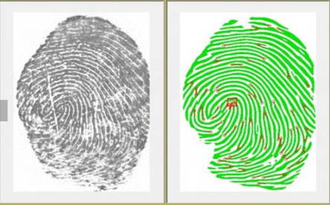
Fingerprint identification
Human fingerprints are unique to each person and can be regarded as a sort of signature, certifying the person's identity. Because no two fingerprints are exactly alike, the process of identifying a fingerprint involves comparing the ridges and impressions on one
fingerprint to those of another. This first involves capturing the likeness of the fingerprint. Once the fingerprint image is captured, the process of identification involves the use of complex algorithms (mathematical equations) to compare the specific features of that fingerprint to the specific features of one or more fingerprint images that have been previously stored in a database.

Slide 9
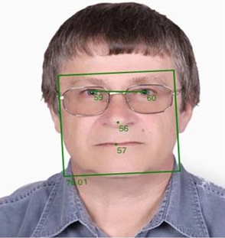
Face identification
Face recognition can be an important alternative for selecting and developing an optimal biometric system. Its advantage is that it does not require physical contact with an image capture device (camera). A face identification system does not require any advanced
hardware, as it can be used with existing image capture devices (webcams, security cameras etc.). Thus, facial recognition should be considered as a serious alternative in the development of biometric or multi-biometric systems.

Slide 10
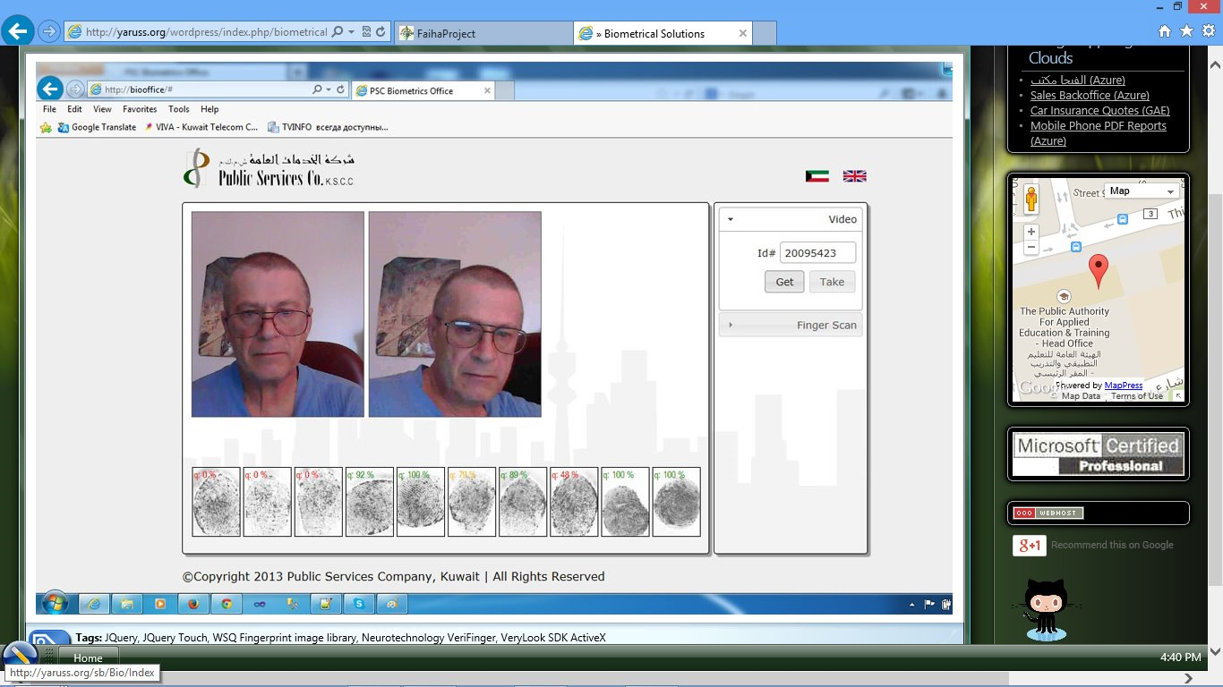

Slide 11
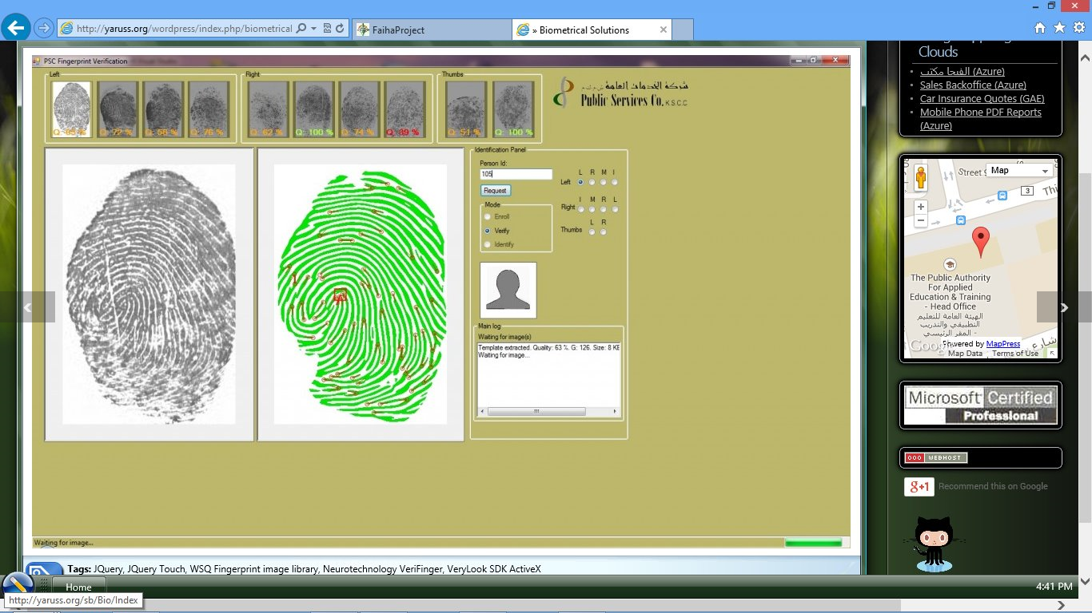

Slide 12
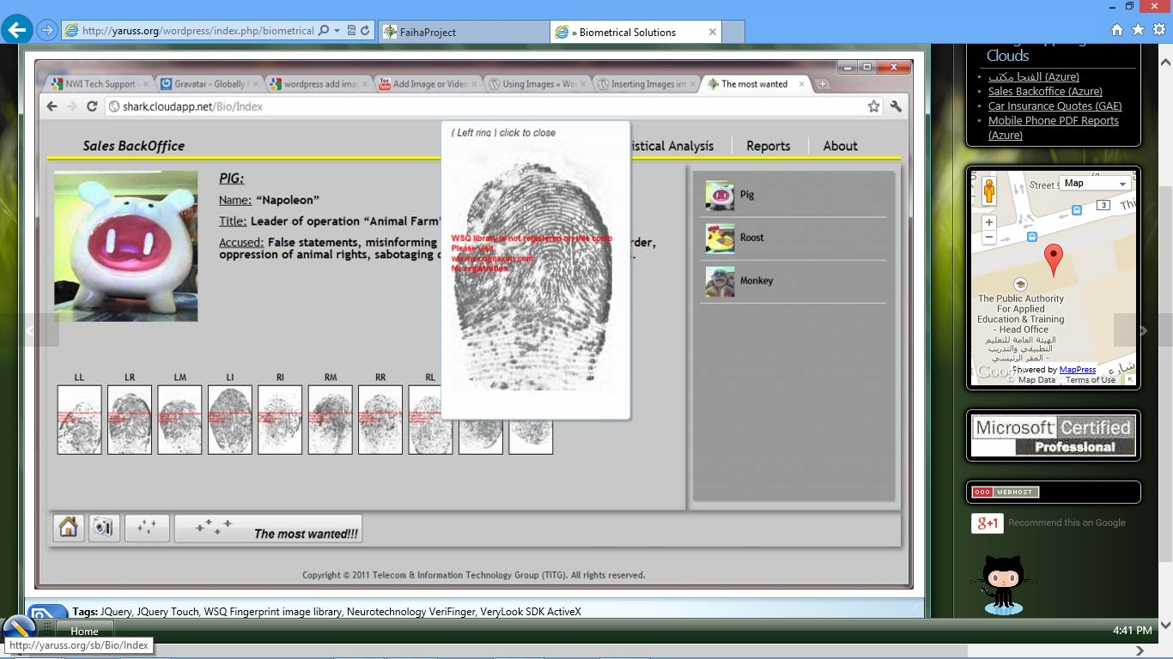

Slide 13
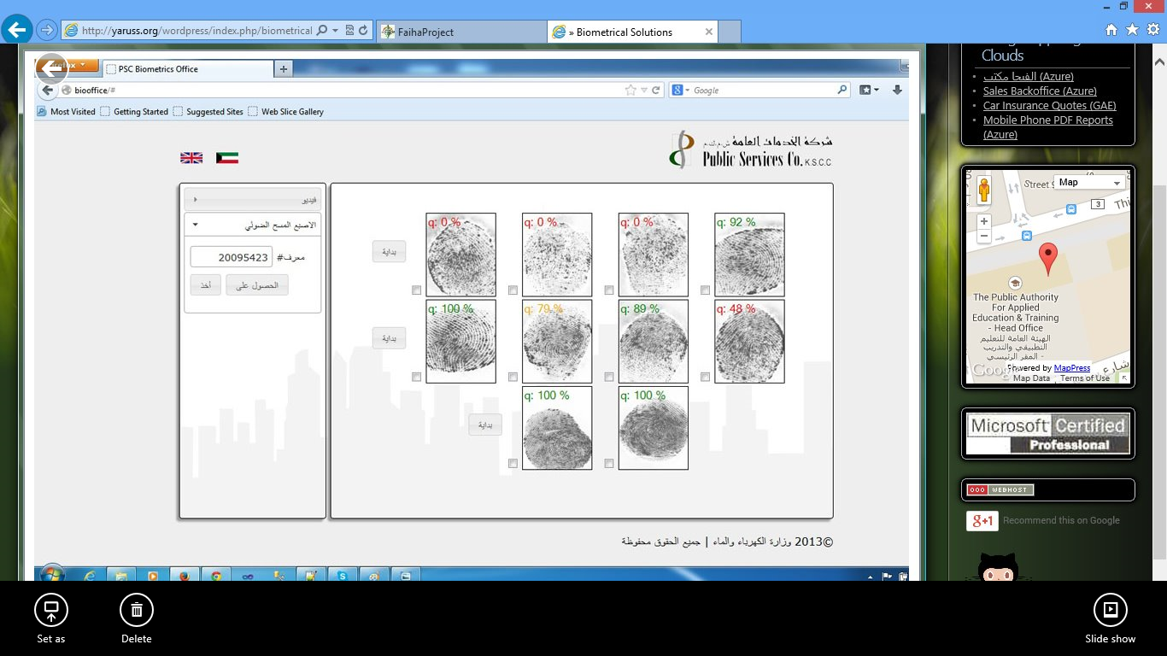

Slide 14
